Slide 1
Convincing Others To Do Test Driven Development
by Jon Kruger

Slide 2
Problems
People are resistant to change
People don’t know about TDD
TDD takes a lot of practice
TDD takes too much time
It will take too long to learn how to do TDD
We don’t know where to start
We can’t test our codebase
Egos

Slide 3
You
Check your own ego – you are helping people to make their lives better
Know how to teach TDD

Slide 4
Them
Never put other people’s code down
Win the respect of your team members
Be encouraging
Find allies

Slide 5
What’s in it for me?
People need a reason to change
People are worried that they will fail
People are worried that getting up to speed with something new will affect their performance
Looming deadlines

Slide 6
Team
Encourage the success of the team, not the success of individuals
Your process should reward team success, not individual success
Create a learning culture
Pair programming
Practice

Slide 7
Get Help
Bring in experienced TDD developers to help mentor your team
Know who to ask when you need help

Slide 8
Small wins
Test-drive a new feature
Refactor a small piece of functionality and write tests for it
Don’t try and rewrite the entire app!

Slide 9
Win over management
Have the boss let the team know that TDD will be a priority
Make sure that the team has the tools they need to succeed
Training time
Get help

Slide 10
The Sales Pitch

Slide 11
Case Studies
We don’t know what code is supposed to do
“The Legacy Codebase”

Slide 12
Case Studies
We can’t prove that our code is working without someone manually verifying that it works
“The Last Minute Change”

Slide 13
Case Studies
Bugs are a waste of time
“The Infinite Loop of Bugs”

Slide 14
Case Studies
Low standards of quality
“Throwing It Over the Wall”

Slide 15
Case Studies
Bugs can be really expensive to fix
“Explosions and Blackouts”

Slide 16
Case Studies
Over time, code bases tend to become more chaotic and painful to work with
“The Maintenance Nightmare”

Slide 17
Case Studies
Measure the right things
“Used Car Salesmen”

Slide 18
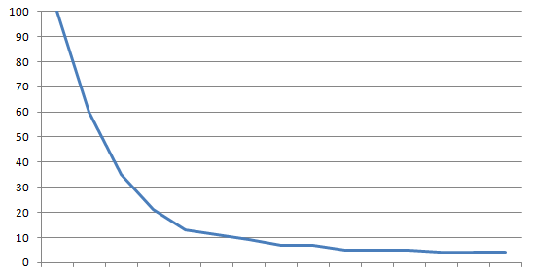
The total cost of owning a mess
Productivity
Time

Slide 19
How can we solve these problems?
We need a way to ensure that our code is working
We need a way to ensure that our code will continue to work after someone changes it
We need a way to figure out what code is supposed to do
We need to make software development less stressful

Slide 20
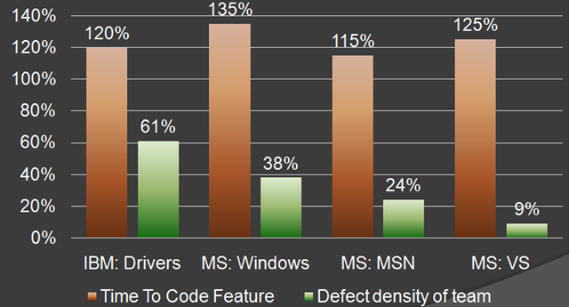
The Cost of Unit Testing
Source: http://blog.typemock.com/2009/03/cost-of-test-driven-development.html

Slide 21
“If I don't need to make it work, I can go a lot faster.”
-- Kent Beck

Slide 22
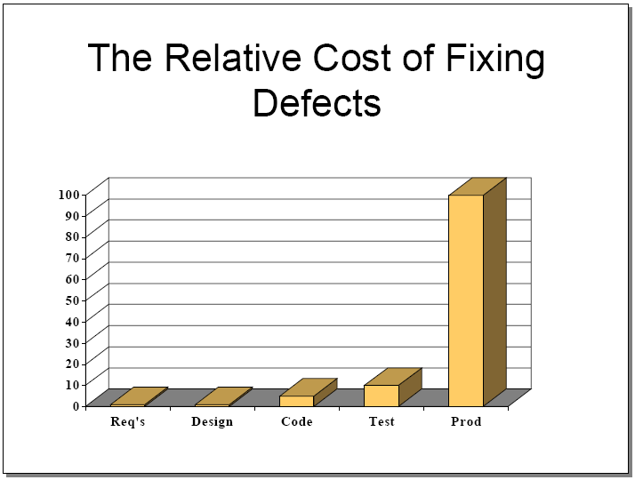
The Cost of Not Unit Testing
Source: http://www.riceconsulting.com/public_pdf/STBC-WM.pdf

Slide 23
The Cost of Not Unit Testing
More regression testing
Too expensive to make changes to software
Software rewrites

Slide 24
What is Test Driven Development?
A software development technique where you write automated unit tests before you write your implementation code
A technique for ensuring good quality and good design
Awesome!

Slide 25
Why is testing first better?
Concentrate on what the code is supposed to do (without worrying about implementation)
We don’t write more code than we need to write
We have a goal to shoot for
We know when we are done
We will write fewer bugs
You can’t cheat and blow off the tests
TDD helps design our code
We will write testable code
If you’re going to write tests, why not write them first?

Slide 26
What’s in it for me?
Proof that your code works
Fewer bugs (both now and in the future)
Freedom to refactor without fear of breaking things
Prevent code from becoming legacy code
Peace of mind

Slide 27
Resources - Cost of unit testing
Microsoft Research – “Realizing quality improvement through test driven development: results and experiences of four industrial teams”
http://research.microsoft.com/en-us/projects/esm/nagappan_tdd.pdf
Cost of Testing, by Misko Hevery (Agile Coach/Java developer at Google)
http://misko.hevery.com/2009/10/01/cost-of-testing/
TDD Derangement Syndrome, by Uncle Bob Martin
http://blog.objectmentor.com/articles/2009/10/07/tdd-derangement-syndrome

Slide 28
Resources – Learning TDD
Behavior Driven Development
http://www.code-magazine.com/article.aspx?quickid=0805061&page=1
So How do You Introduce TDD into an Organization or Team?, by Jeremy Miller
http://codebetter.com/blogs/jeremy.miller/archive/2006/06/27/146899.aspx
How to get started with TDD, by Misko Hevery (Java examples)
http://misko.hevery.com/2009/11/17/how-to-get-started-with-tdd/
TDD Starter Kit – Sample Projects and Links (C# examples)
http://jonkruger.com/blog/2009/07/23/tdd-starter-kit-sample-projects-and-links/
Pair Programming Bot
http://pairprogrammingbot.com/

Slide 29
Resources – Practice!
String Calculator kata
http://osherove.com/tdd-kata-1/
Bowling Game kata
http://butunclebob.com/ArticleS.UncleBob.TheBowlingGameKata
Prime Factors kata
http://www.butunclebob.com/ArticleS.UncleBob.ThePrimeFactorsKata
Katacasts (watch screencasts of people doing various katas)
http://www.katacasts.com/

Slide 30
My Info
Email: jon@jonkruger.com
Twitter: @JonKruger
Blog: http://jonkruger.com/blog
.NET TDD Training: http://tddbootcamp.com

